Slide 1
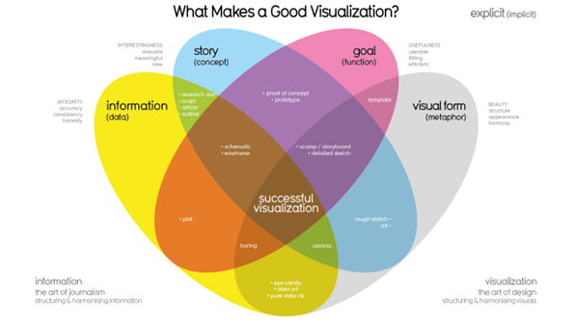
Student Name, ID: Sanad Alawi, 21110042
Instructor: Doctor Sinan Kamal
-------------------------------------------------------
Course: Data Visualization
Section: 1
Date: 1 – 30 – 2024, Thursday
Notes:
مرحبا , السلام عليكم دكتور سنان
أتمنى أن يكون يومك جميل وبأنك تستمتع معي في ال
Presentation
اليوم

Slide 2

Cheetah Telecom
Notes:
Good morning beautiful stakeholders from Cheetah Telecom!
اصحاب شركة
Shop Manager, CEO, all members!

Slide 3
Goals
Make Data-Driven, Informed Decision-Making
Eliminate Hard-to-Read, Hard-to-Interpret, Hard-to-Everything Excel Files
Dashboards-Specific for Operational, Tactical, and Strategic Stakeholders
Boost Sales and Business Performance
Gain a Competitive Edge in the Competitive Market
Deliver Actionable Insights, Recommendations, and “Aha!” Moments

Slide 4
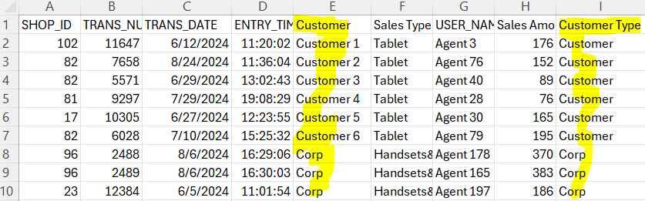
Data

Slide 5
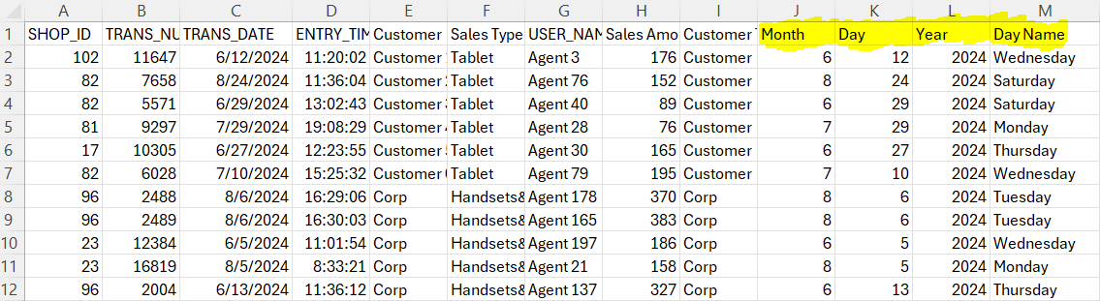
Data

Slide 6
Future Improvements
Collect More Data – Deeper Insights
Customer Demographic information – Personalization
Missing Values – Better Quality Data

Slide 7

Dashboards
Notes:
Evaluate
How they will help you?
Recommendations

Slide 8
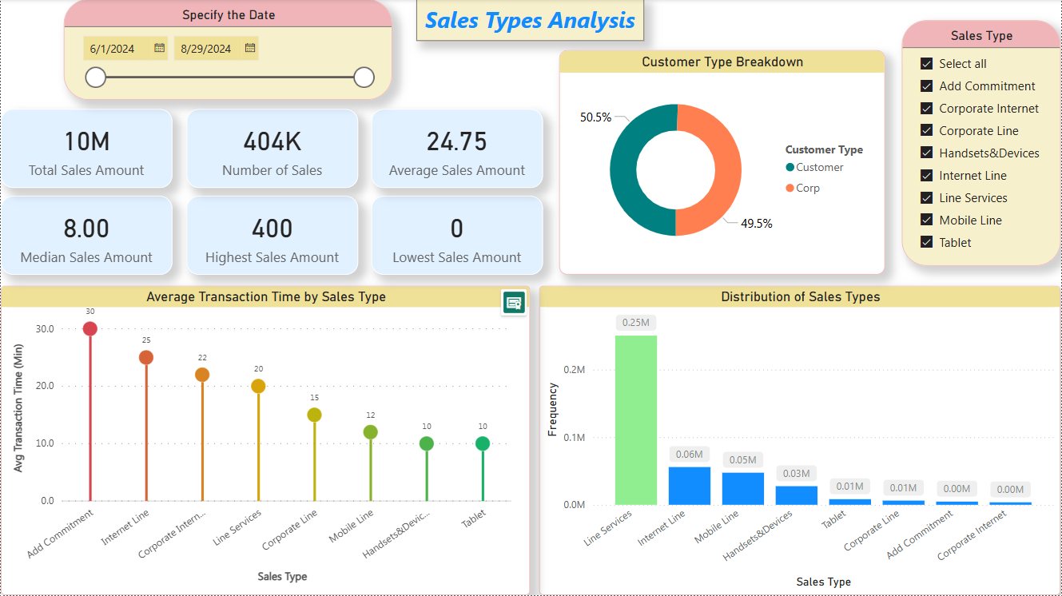
Dashboard 1 – Operational

Slide 9
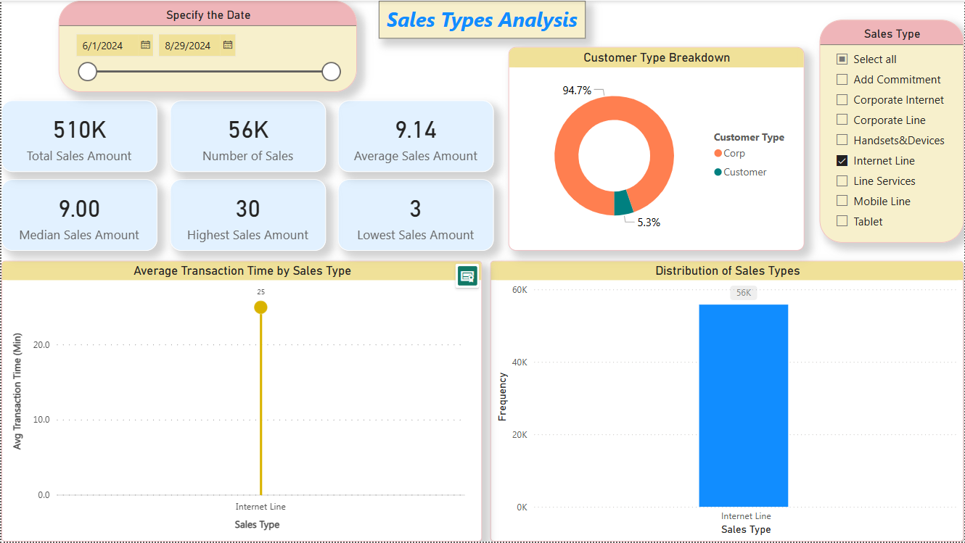
Dashboard 1 – Operational
Notes:
Fast, Strong Recommendation from this dashboard

Slide 10
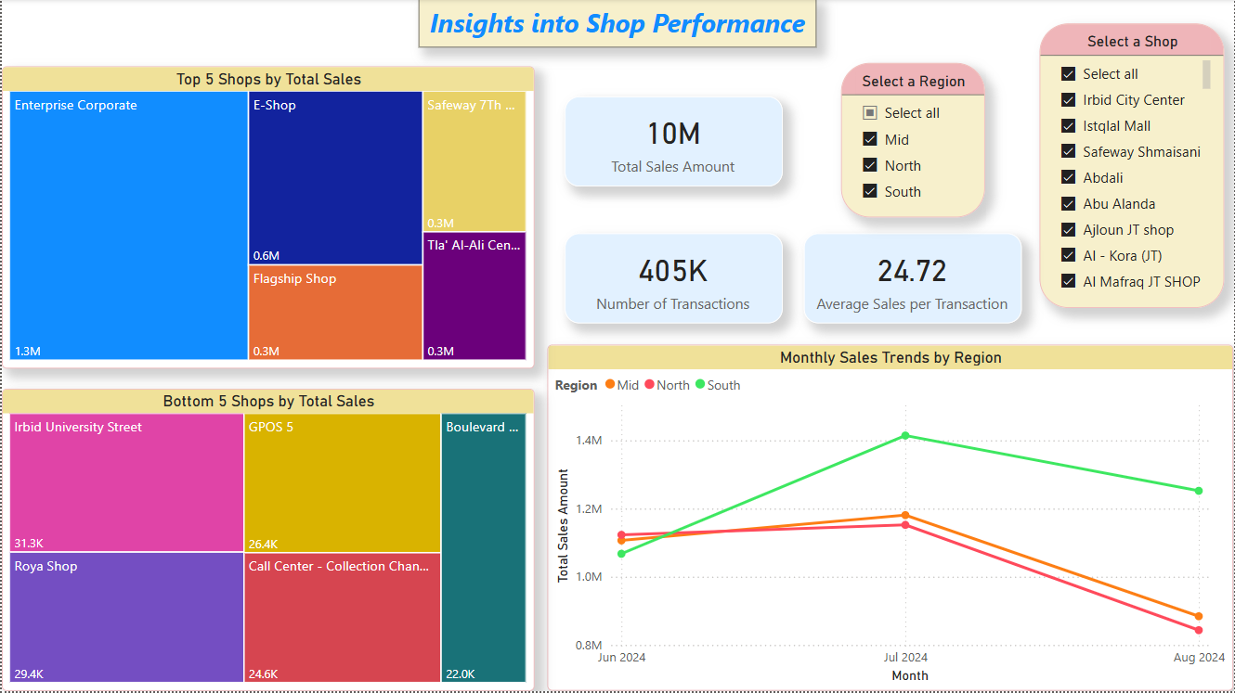
Dashboard 2 – Tactical
Notes:
Quick Insight
South → Perfect
Mid, North → Something is wrong, what is happening right there?

Slide 11
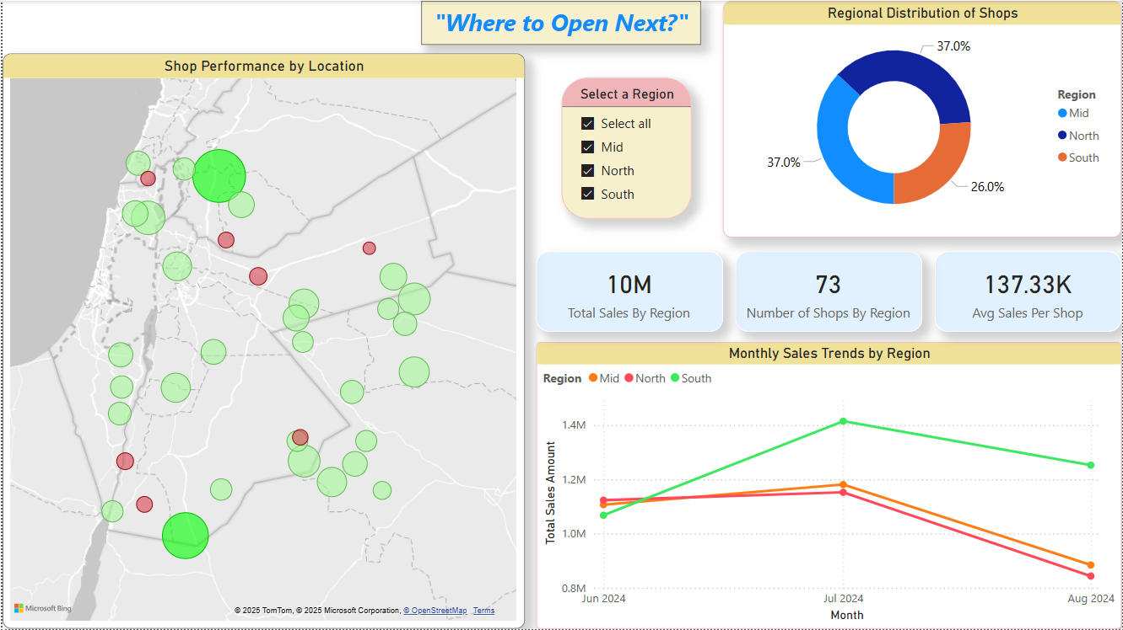
Dashboard 3 – Strategic
Notes:
Where to Open Next?
South!

Slide 12
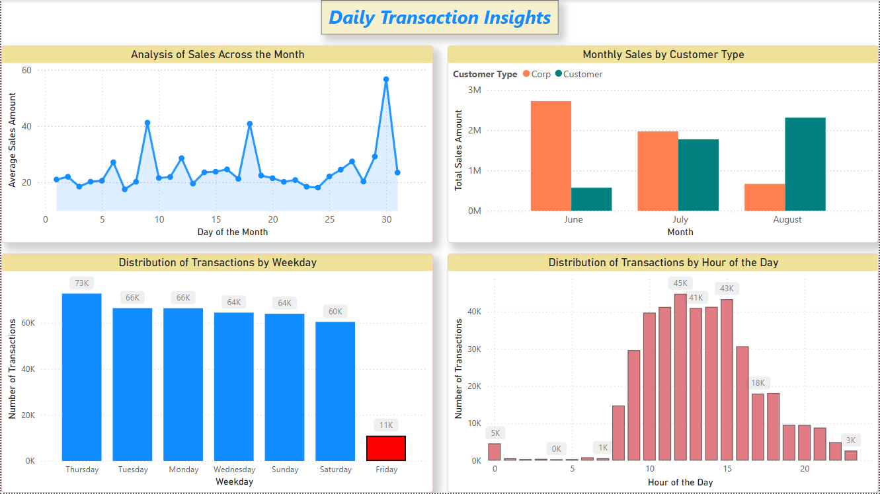
Dashboard 4 – Operational
Notes:
Take a holiday at Friday – No Problem!!
You can take a break, before 10 Am and After 3 pm,
But between 10 Am and 3 pm, never take a break please ☺

Slide 13
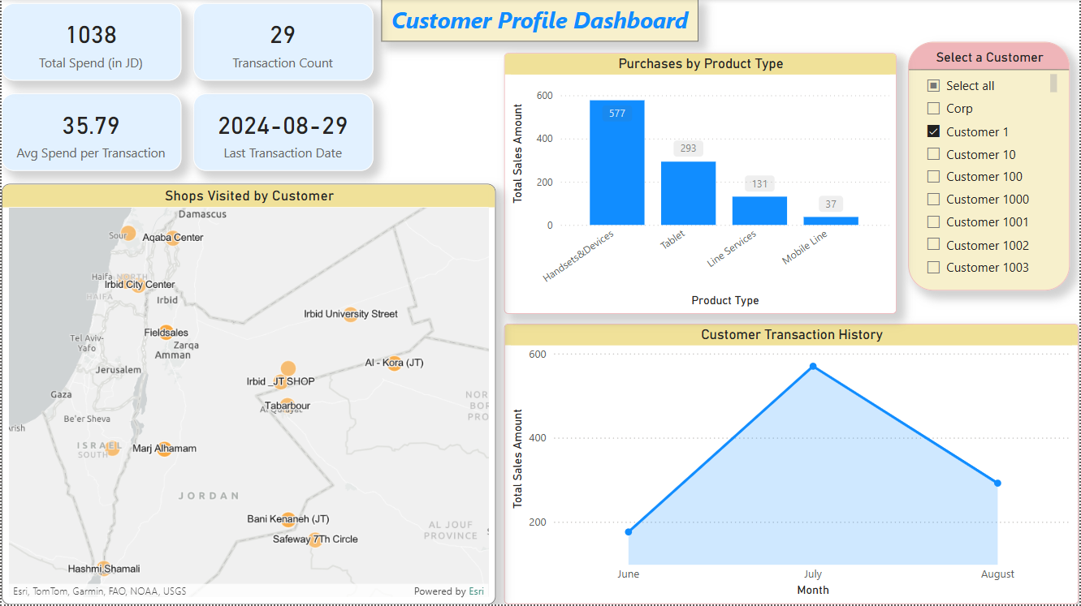
Dashboard 5 – Operational
Notes:
High Personalization!
Customer 1 – do you need a headset dear?

Slide 14
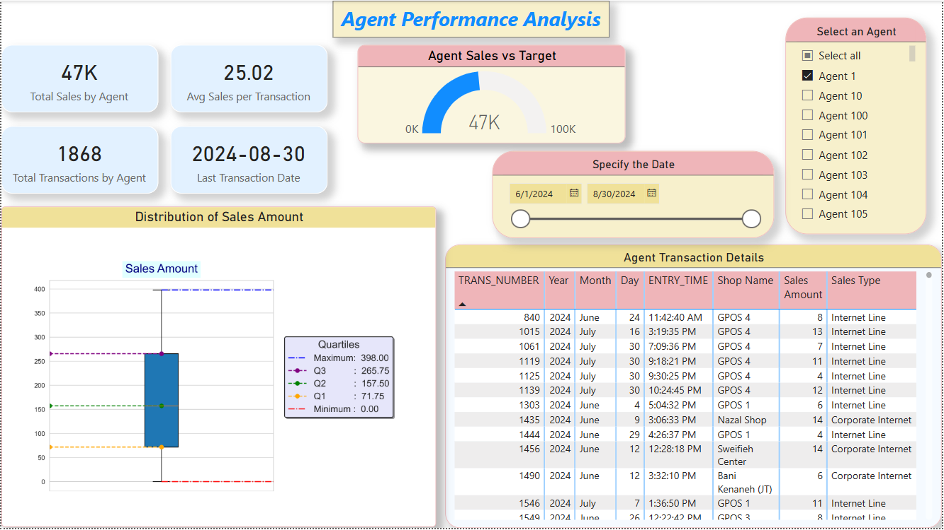
Dashboard 6 – Tactical
Notes:
Agent 1 you are amazing !!
Agent 2 you are horrible !!

Slide 15
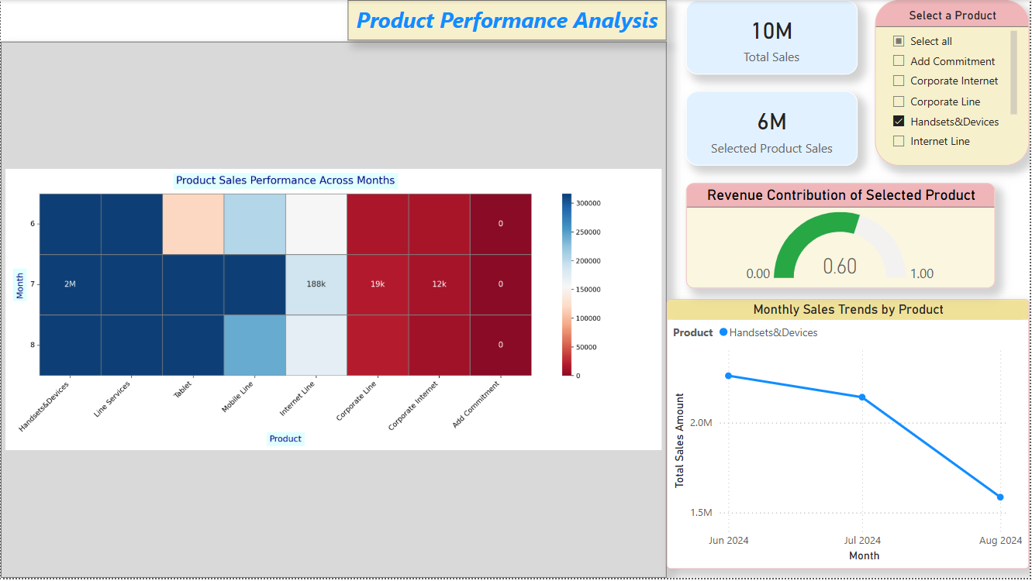
Dashboard 7 – Strategic
Notes:
Headsets and Devices – Amazing
Internet Line – Okay
Add Commitment – OMG

Slide 16
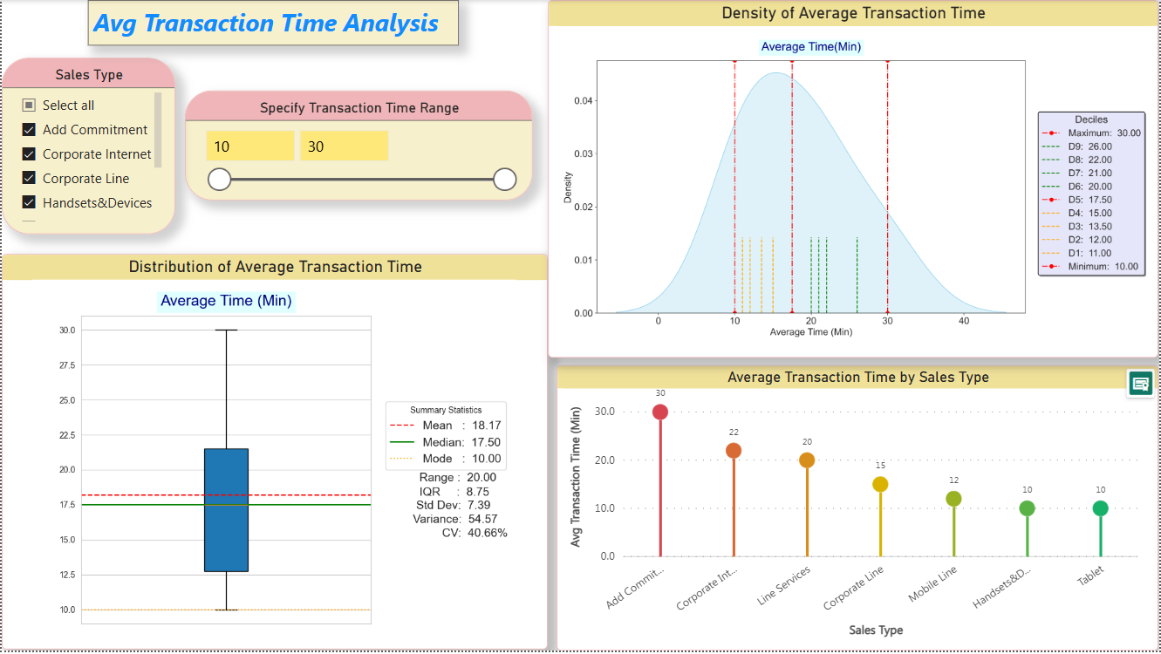
Dashboard 8 – Tactical
Notes:
Add Commitment – Really slow, what Is wrong, why?
Let’s compare it with others…

Slide 17
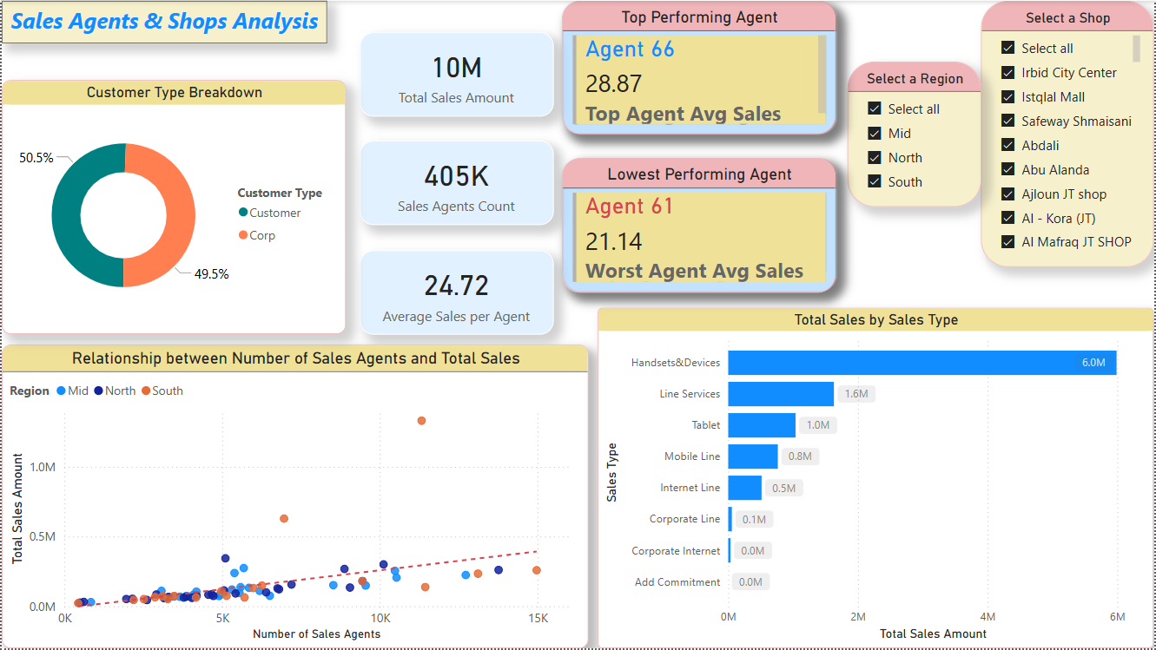
Dashboard 9 – Tactical
Notes:
Who is the top-performing agent?
Who is the worst-performing agent?
What is the relationship between number of sales agents and total sales?

Slide 18
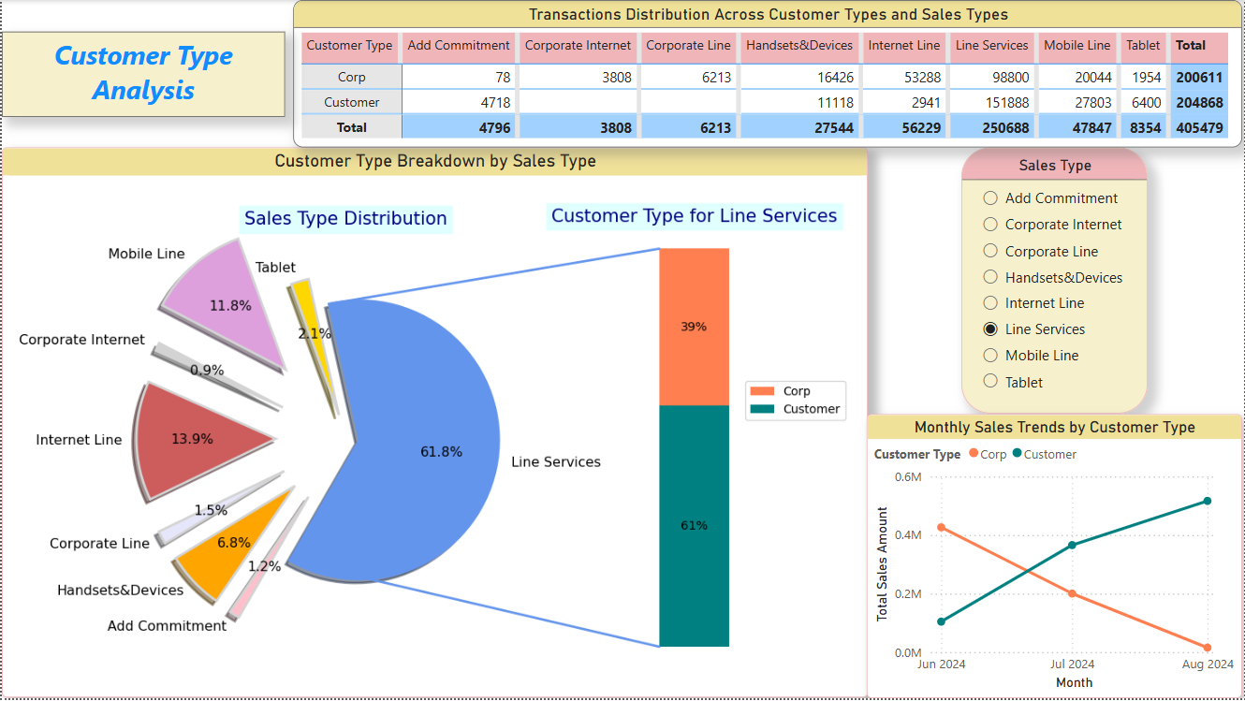
Dashboard 10 – Tactical
Notes:
Here is the challenge dashboard!
If any other vendor, can offer you this level of interaction and details!
Take the dashboard for free and we don’t need any money!
We are confident that nobody will give you this level of detail…

Slide 19
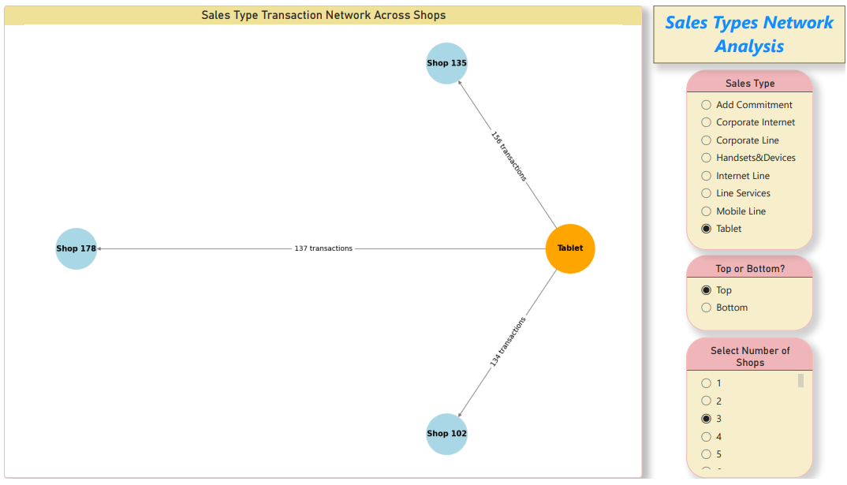
Dashboard 11 – Tactical

Slide 20
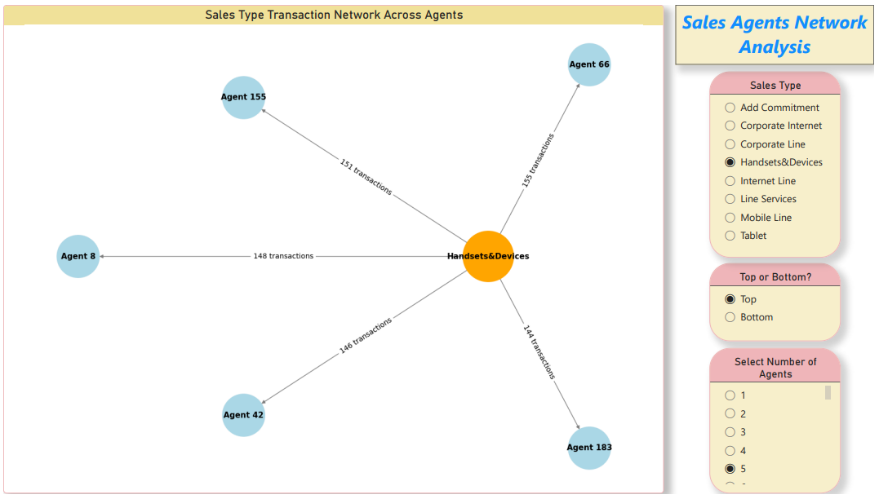
Dashboard 12 – Tactical

Slide 21
Efficiency and Effectiveness of the Dashboards?
Pros
3 Operational, 7 Tactical, and 2 Strategic Dashboards, ensuring insights for all levels of stakeholders.
Each dashboard tells a clear story and serves a specific business objective.
Well-structured dashboards with KPIs, slicers, and a mix of visualizations – neither overwhelming nor lacking details.
Allows stakeholders to explore data meaningfully and uncover valuable insights.
Thoughtful use of colors, avoiding purple to accommodate stakeholders with colorblindness.

Slide 22
Cons
Not Real-Time Dashboards: Requires API integration for real-time data updates.
Customization Needs: Some users may require additional filters or specific views for personalized insights.

Slide 23
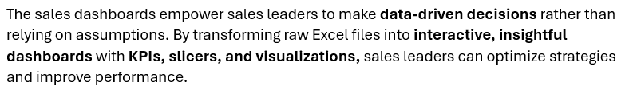
Impact of Sales Dashboards on Decision-Making

Slide 24
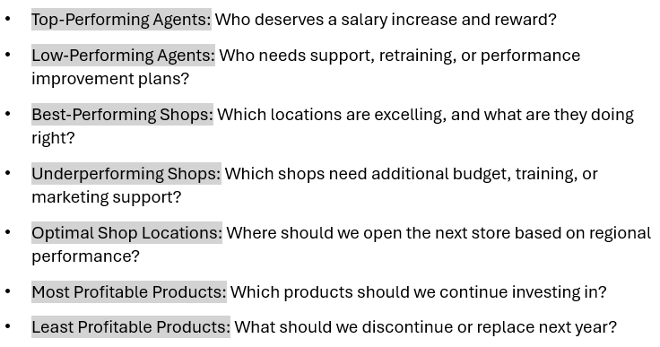
These dashboards help answer critical business questions, such as:

Slide 25

Any Questions?
Notes:
Any question
Any Inquiry?

Slide 26
The End ☺

